Slide 1
EXCEL DASHBOARD-SALES TREND
About me,
NAME: HAMSA GEETHA K V
COLLEGE: Vel tech high tech engineering college
DEPT: Artificial intelligence and data science- III yr
GITHUB : https://github.com/HAMSAGEETHAKV
I am highly motivated and dedicated individual with a passion for learning. I have demonstrated a strong work ethic and a commitment to excellence in everything that I do.

Slide 2

ANALYZING SALES TREND
Analyzing sales trends means looking at how well a company's products or services have been selling over time.
It helps businesses figure out what's working, what's not, and how to make more money by understanding what customers like and don't like.
By studying past sales data, companies can make smarter decisions to improve their sales and grow their business.
This comprehensive analysis not only aids in adapting to changing market conditions but also plays a fundamental role in maximizing revenue, enhancing customer experiences, and shaping future business directions.

Slide 3
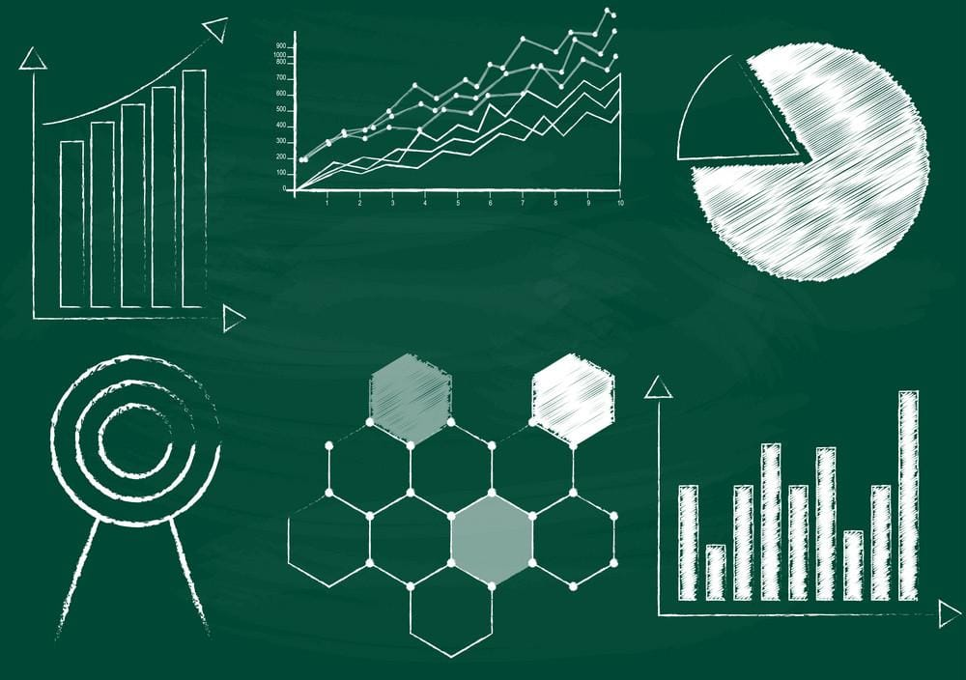
PROBLEM STATEMENTS
1.What is the overall sales trend in the year 2017?
2. How have sales varied across different location or markets?
3. What are the top-performing products in Chennai and bangalore?
4.Can we identify any potential opportunities for growth or areas that require strategic improvements based on the sales trend analysis in cosmetics on the location Chennai and bangalore?
5.Select the top sales representative and top 3 customers for the product electronic over the period of 2016,2017 and 2018.

Slide 4
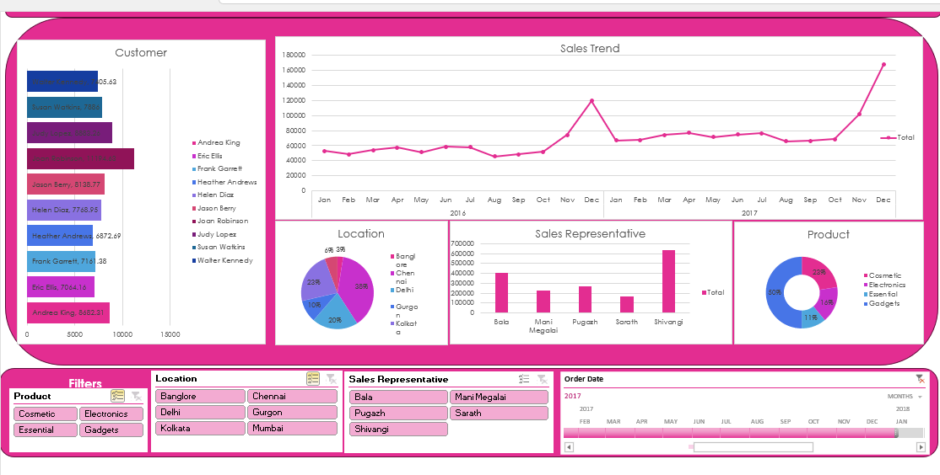
1.What is the overall sales trend in the year 2017?

Slide 5
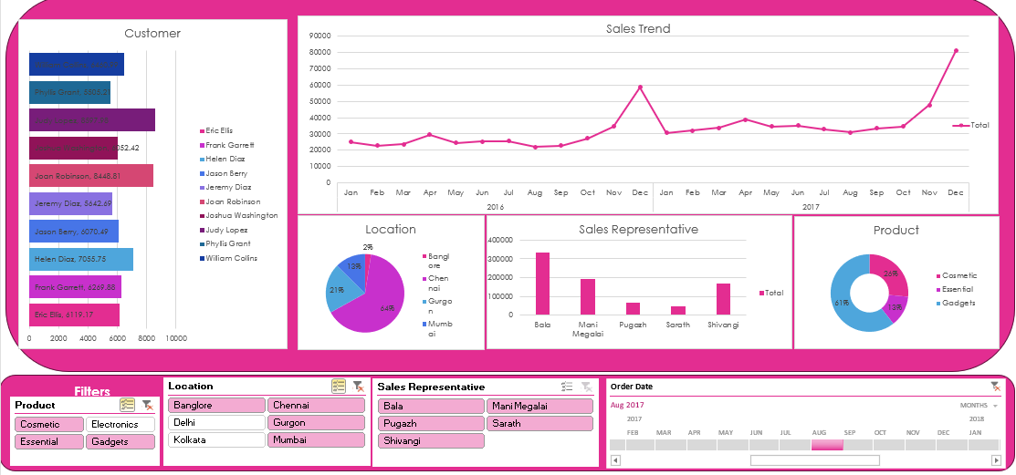
2. How have sales varied across different location or markets?

Slide 6
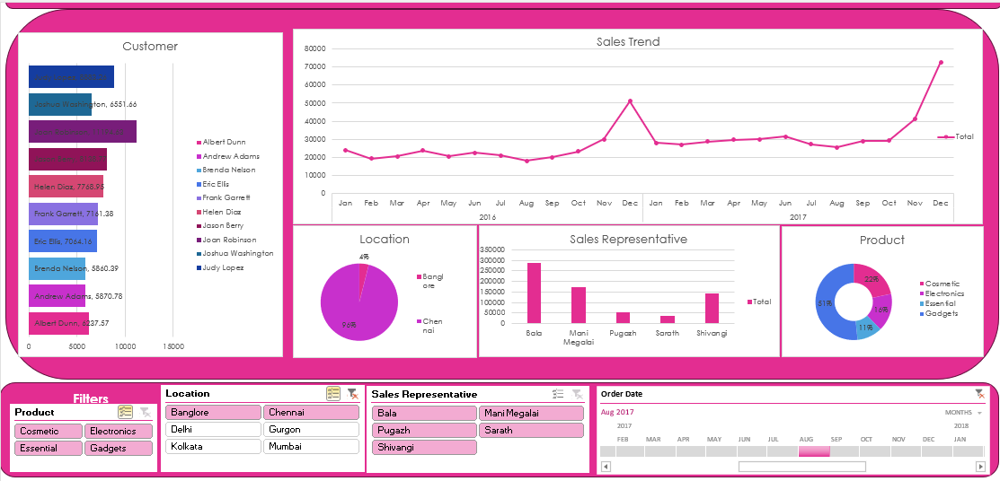
3. What are the top-performing products in Chennai and bangalore?

Slide 7
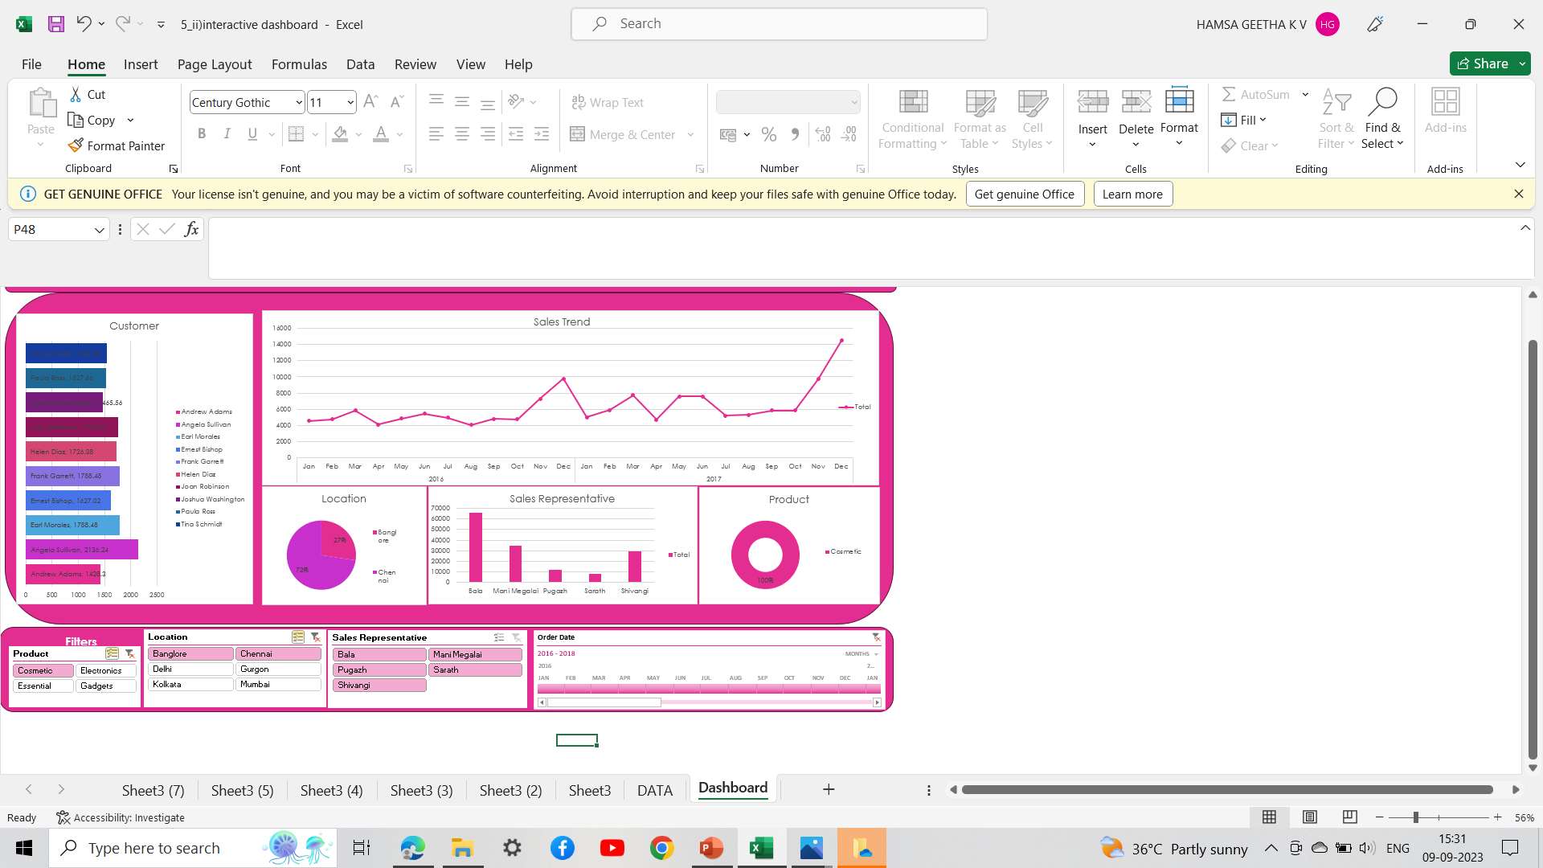


4.Can we identify any potential opportunities for growth or areas that require strategic improvements based on the sales trend analysis in cosmetics on the location Chennai and bangalore?
As the sales were increasing during the month October to December.We can implement some improvements for growth,which include
Identify which cosmetics products are in high demand.
Evaluate the performance of your stores/locations in Chennai and Bangalore.
Ensure that your cosmetics products meet all regulatory standards and safety requirements.
Invest in staff training to provide better customer service and product knowledge.
e-commerce capabilities to tap into the growing online cosmetics market.

Slide 8
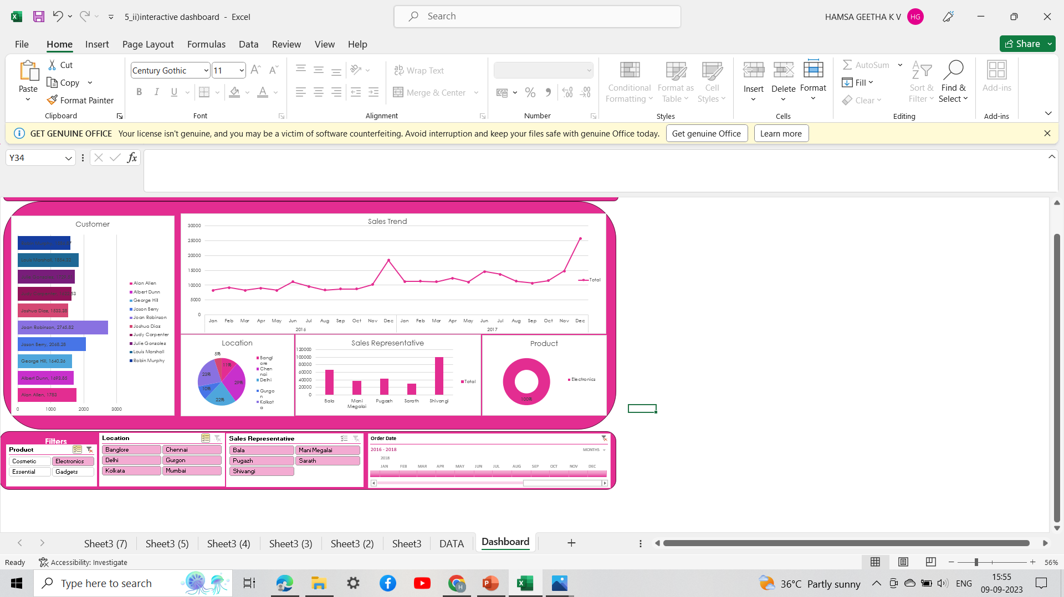



5.Select the top sales representative and top 3 customers for the product electronic over the period of 2016,2017 and 2018.
Top Sales representative:
Shivangi
Top 3 customer:
1.Joan robinson
2.Jason berry
3.Louis marshall

Slide 9

APPROACH
Structure Your Data
Perform Descriptive Analysis
Visualize the Data - Choose appropriate chart types (e.g., line charts, bar charts) to visualize sales trends
Add Interactivity- Insert slicers or drop-down lists that allow users to filter data by date range, product, or other relevant criteria. Use Excel's PivotTable and PivotChart features to create dynamic, interactive elements.
Compare Performance- Compare sales performance across different products, regions, or customer segments using charts and tables.
Finalize and Share- Finalize your Excel dashboard by adding titles, labels, and any additional instructions.
Update and Maintain- Set up a process for regularly updating your dashboard with new sales data to keep it current.

Slide 10

INSIGHTS
During the holiday season (November and December), we consistently observe a significant spike in sales across all product categories.
This seasonality trend has been consistent over the past three years, indicating that customers are more active during the year-end holidays.
To capitalize on this trend, we should consider planning special promotions, expanding inventory, and boosting marketing efforts during this period to maximize revenue.
This insight highlights the impact of seasonality on sales and suggests a specific strategy for leveraging this trend to drive business growth during the holiday season.

Slide 11
CONCLUSION
In conclusion, our analysis of sales trends has provided valuable insights into the performance of our products and the behavior of our customers over the past 3 years.
Several key takeaways emerge from this analysis:
Seasonality Impact
Product Performance
Marketing Influence
Regional Variations
Customer Segmentation
DATASET LINK: https://drive.google.com/folderview?id=1X0vMQG7ldPgHsdq70Msv29F04h6-jO-_

Slide 12
THANK YOU

